Slide 1
The Semantic Kernel Hackathon
NEW: Powered by Design × AI Thinking
Notes:
This is

Slide 2

Agenda
📺
👋 Kickoff and Welcome
🧠 Brainstorming of ideas
👏 Demos
👋 Wrap up and Feedback
Notes:
Welcome to one of many Semantic Kernel hackathons happening across the world. We’re delighted for you to take our many learnings into your organization to bring the productivity benefits of AI into your teams as a game-changing capability.
Kickoff video with John Maeda: https://aka.ms/sk/hack/video/opener

Slide 3
Welcome! Let’s learn about each other…
Notes:
We’re going to pass the baton!

Slide 4
Pass the baton self-intros
One person is selected to self-intro.
They pick the next person to self-intro.
The next person does so too.
The moderator helps to ensure that everyone does a self-intro.
Plus … the moderator reminds everyone to keep it short ☺
Notes:
But before we get going, let’s get to know each other. Let’s start with a baton passing drill – which is also good for building teams across a hybrid environment – where one person is appointed as the starter self-introducer. And then they pass the baton to another person. And so forth until everyone is represented properly. As the moderator, I’ll make sure that you are not missed. Feel free to let me know when I have done so. Because *everyone* counts in a Semantic Kernel hackathon.

Slide 5
Let’s Talk About This Moment …
📺
Notes:
Available video option: https://aka.ms/sk/hack/video/thismoment

Slide 6
What’s the TL;DR of this burning moment in technology?
”AI” has largely been deemed as ”interesting” but not useful enough, yet.
ChatGPT’s popularity has indicated a new willingness to (tenuously) welcome AIs.
FROM (2022)
TO (2023)
Notes:
You’re likely all here because you felt the “sonic boom” of AI at the end of 2022 with the advent of OpenAI’s ChatGPT service. But many of you also have been knowing this one day would come true – you have been a visionary … waiting for this big moment. It’s a moment when AI is finally taken seriously, that has been a long time coming.

Slide 7
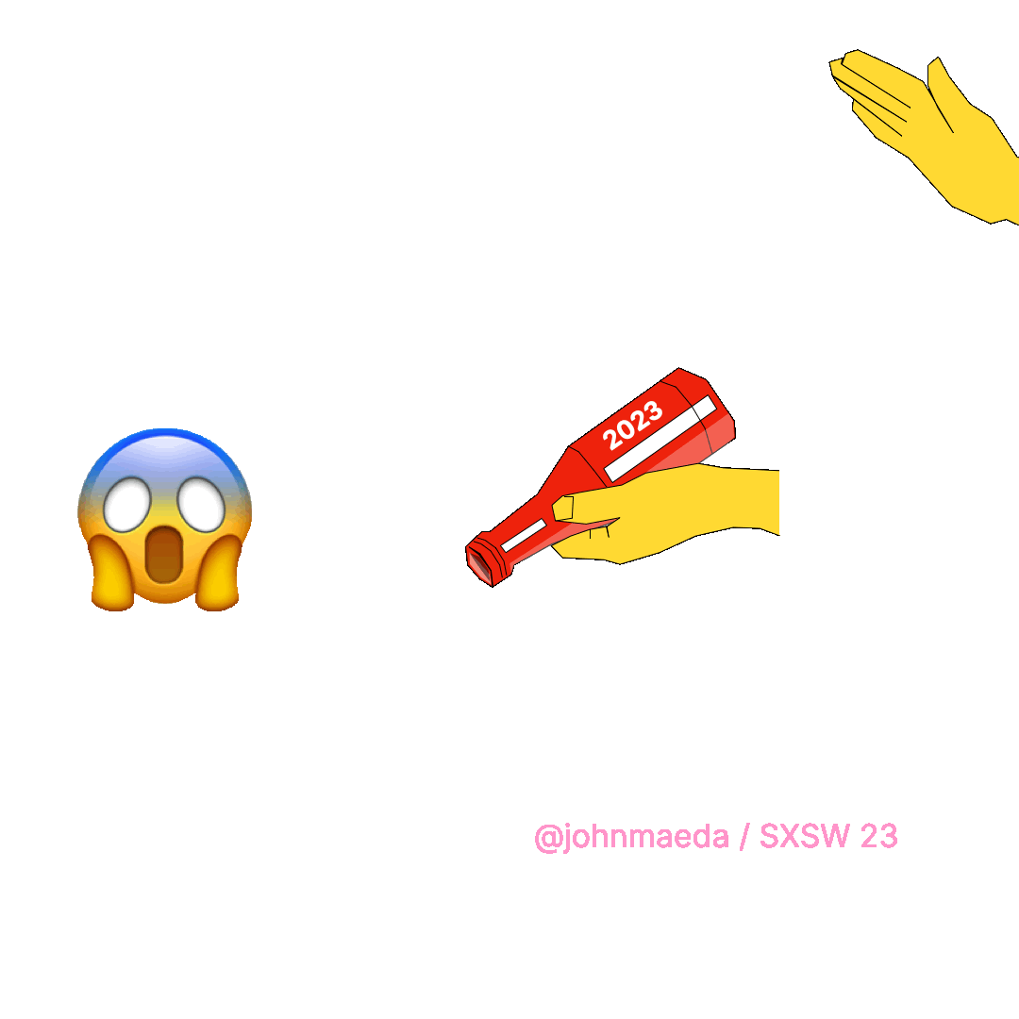
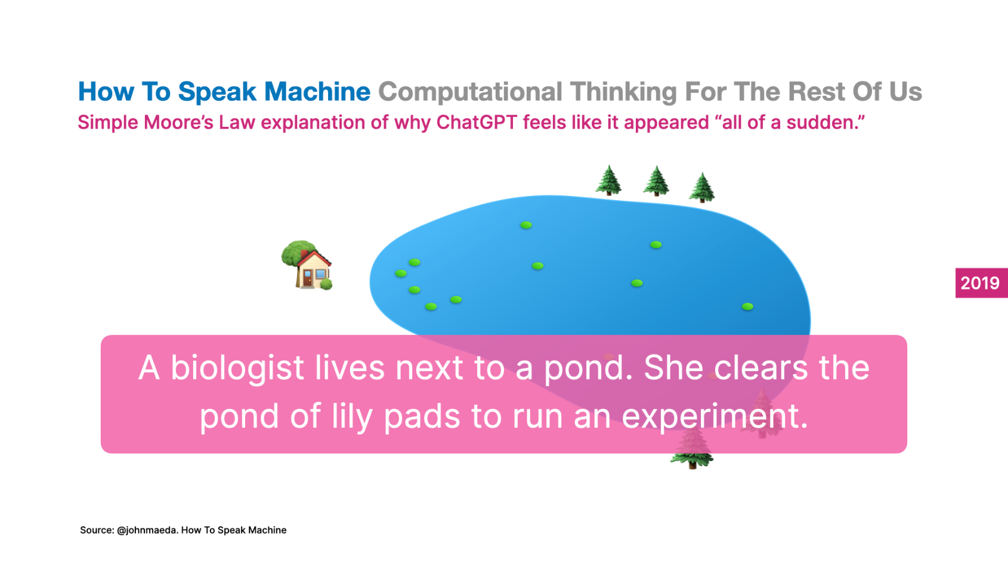
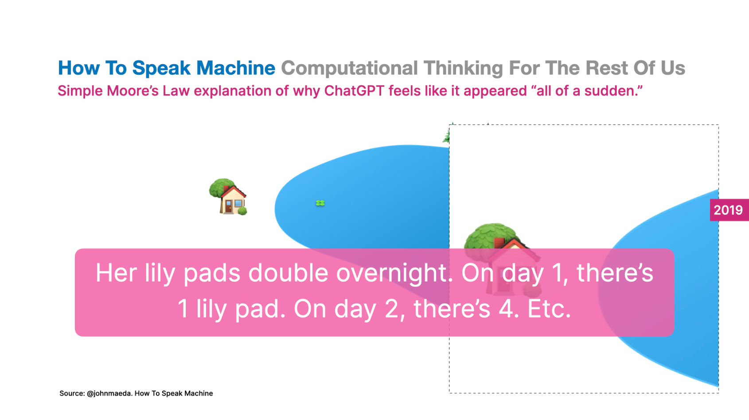
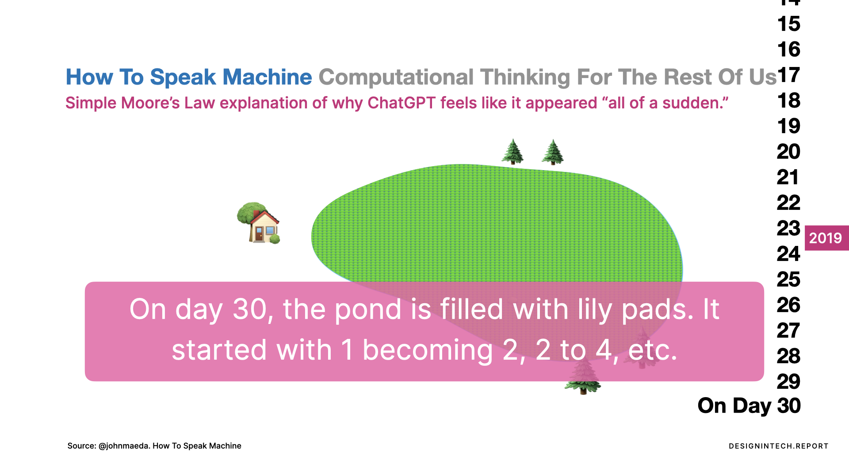
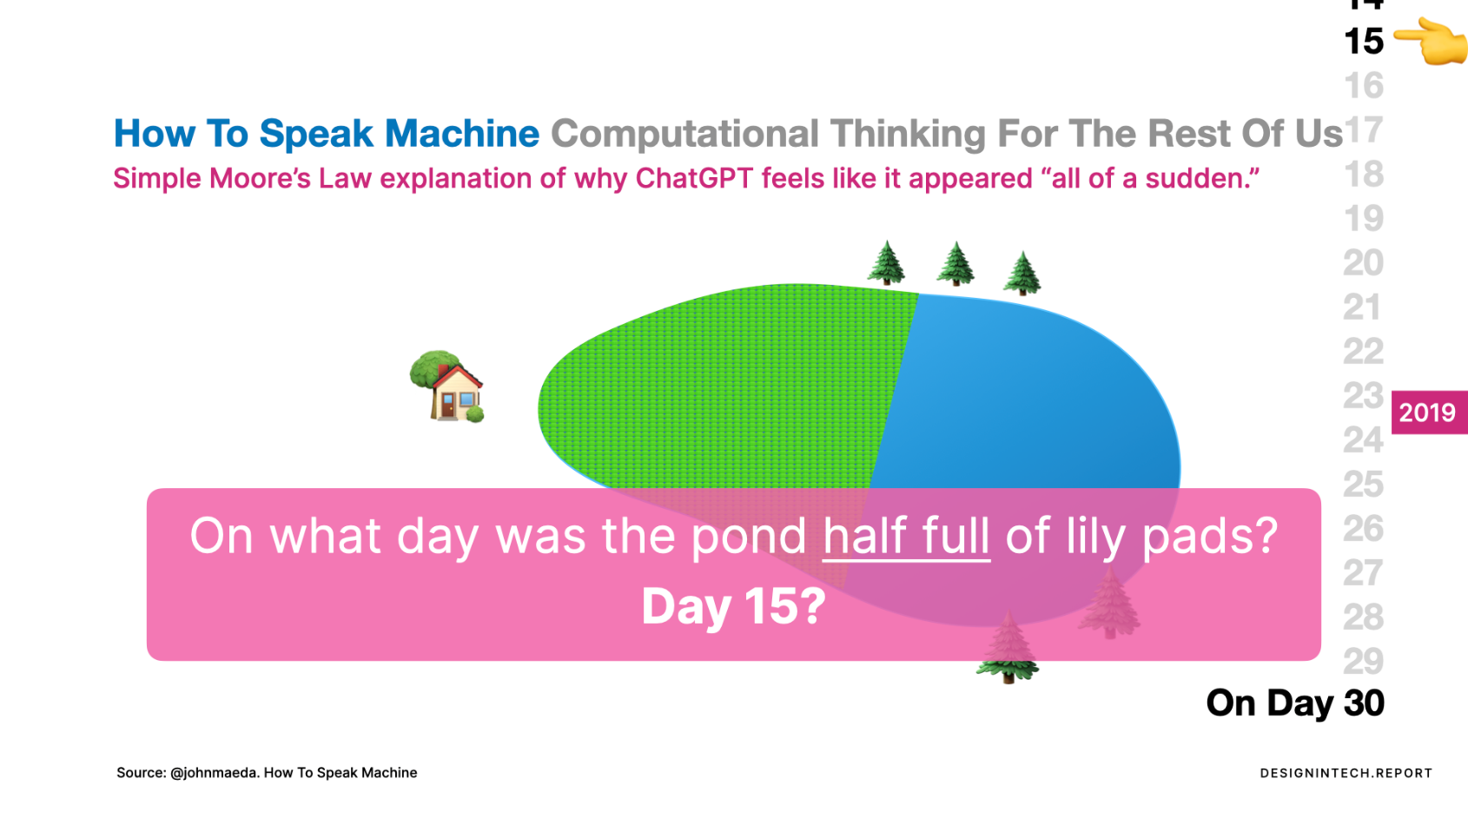
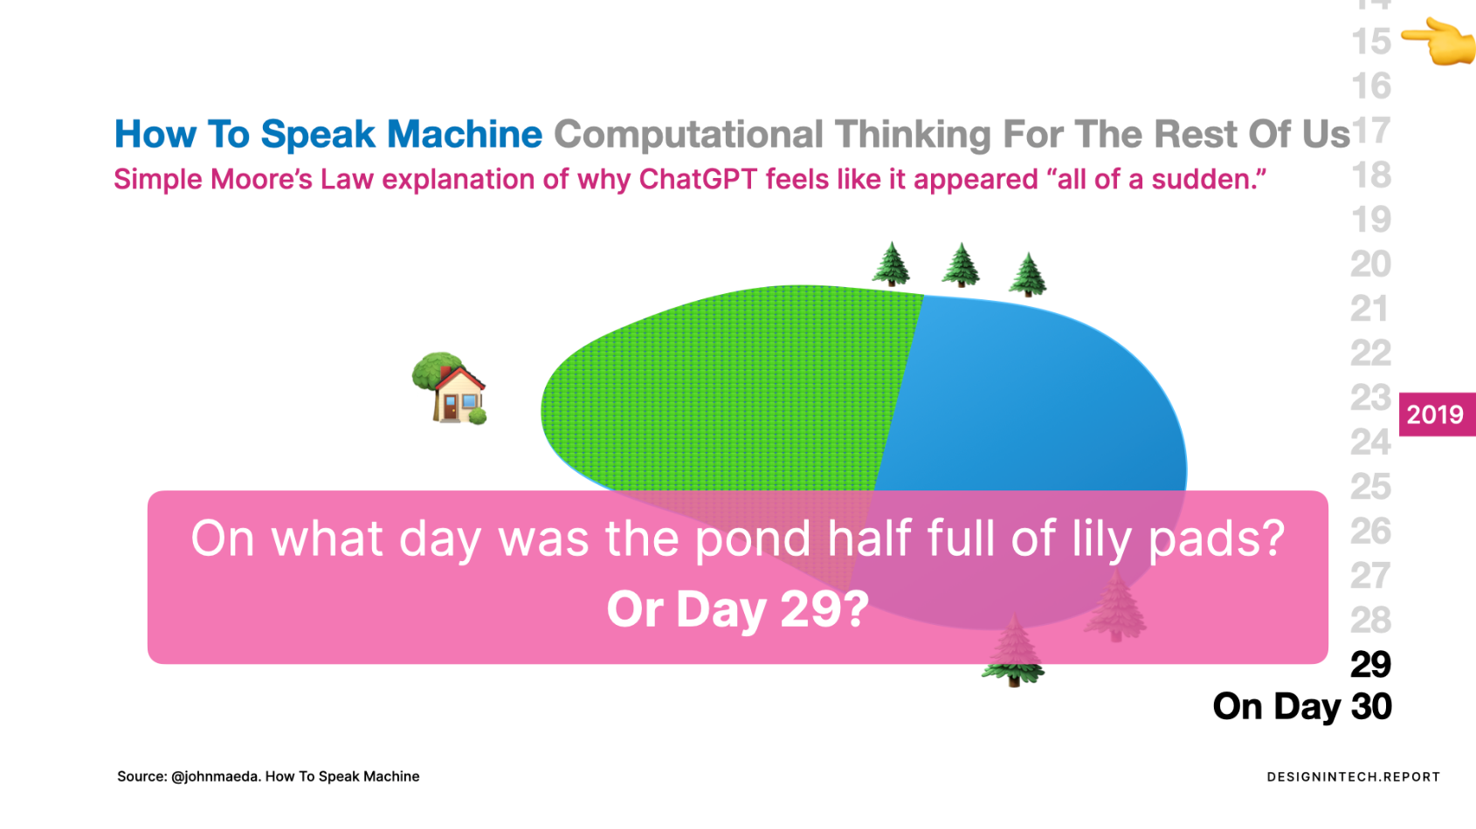
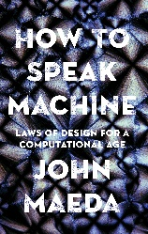
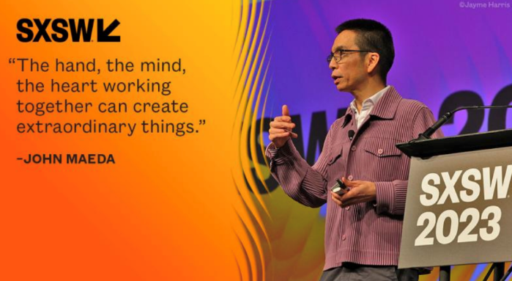
In hindsight, Moore’s Law is what happened to AI …
Moore’s law tends to “catch up” on you
Notes:
Let’s get a sense for how this all happened by drawing upon Moore’s Law. Moore’s Law is the tech industry’s principle that every 1 to 1.5 years, the capability of computing technology doubles.
Dr. John Maeda, VP of Design and AI, wrote a book on this topic called “How To Speak Machine” (2019). It lays out an old British riddle where a pond is cleared of lily pads. And a scientist runs an experiment where she plants one lily pad, that becomes two over night, becomes four the next night, and so forth. The riddle goes, “On day 30, the pond is completely covered with lily pads. So on what day was it HALF covered?”
Most people will say day 15. Because that’s what is half of 30. But the real answer is 29. That’s the day when the lily pads doubled and covered the entire pond.
At SXSW, Maeda dubbed this the “AI Ketchup Bottle Moment” – similar to when a glass bottle ketchup can be fidgeted with so that ketchup might come out. But it doesn’t. Until you whack it one more time and it all comes out. That’s what AI has felt like for many of us in 2023. And get ready for more globs of AI ketchup to come!

Slide 8

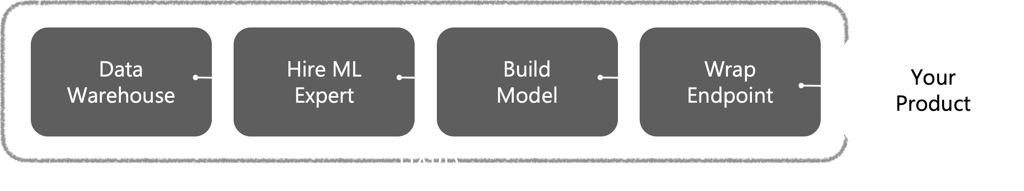

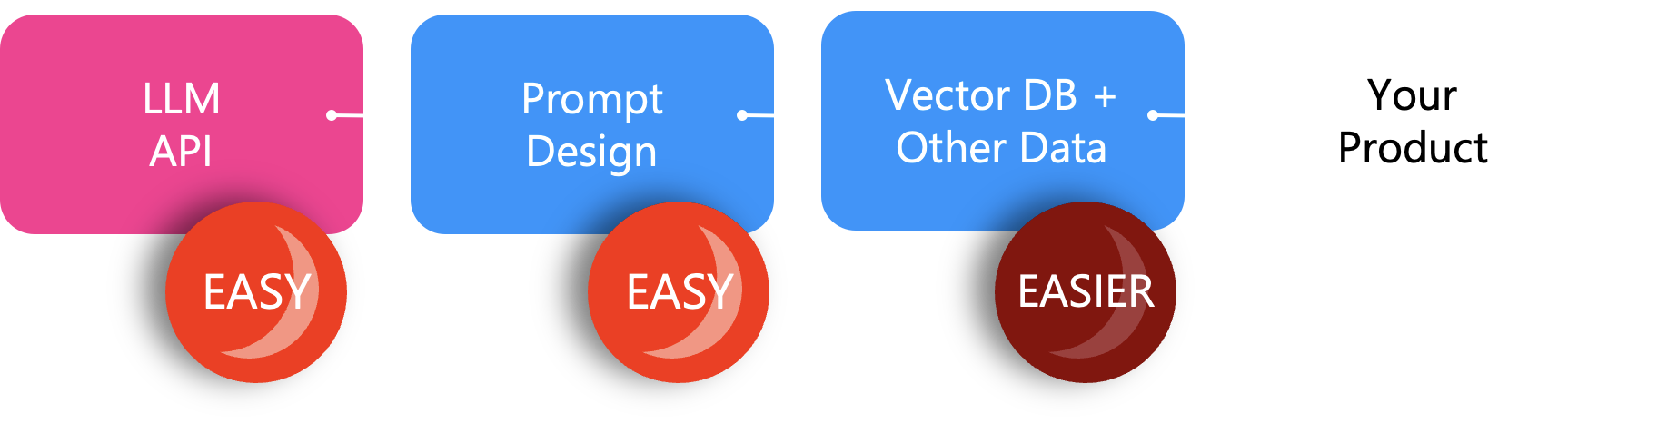



AI Pioneer Herbert Simon’s Scissors have arrived in 2022
TRADITIONAL AI/ML KNIFE “training a model is hard”
🔨
🔨
🔨
🔨
🔨
Machine Learning
COGNITIVE BLADE “pretrained foundation model”
CONTEXT BLADE “specific world knowledge”
SRC: http://web.archive.org/web/20230314173215/https://www.unusual.vc/post/devtools-for-language-models
Notes:
Traditionally, AI/ML has been hard to do for industries of all sizes. You work extremely hard to metaphorically smith a magical steel blade out of iron ore. Iron ore being a metaphor for data. You collect the iron ore, melt it, process it, and pound it into the shape of a knife that can only do one thing. It takes a long time. And it costs quite a bit to make it happen in people costs as well.
AI pioneer Herbert Simon once said that the brain works like two blades of a scissors. One blade is cognition. The other is context. The two together make intelligence happen. By the same token, building with LLM AI has made the creation of AI feature breathtakingly easy. Which is surprising for existing AI/ML practitioners.

Slide 9
TL;DR: This new kind of AI requires a different mental model
LLM AI requires a new way of writing code that’s unfamiliar.
The hard things are easy, and the easy things can seem hard.
You soon run into the limits of what it can’t do out-of-the-box.
Calling OpenAI APIs directly means you’re thinking narrowly.
You need new tools that 10X your value and velocity with AI.
Picture infinite chats, long-running tasks, + connectors.
Notes:
Because it’s so much easier – and also harder in brand new ways – you will run into roadblocks in developing with this new kind of AI. We’ve largely addressed those issues with Semantic Kernel. So that you can run at speed, and not get slowed down by things that a good SDK should solve for you.

Slide 10
Get To Know Semantic Kernel

Slide 11


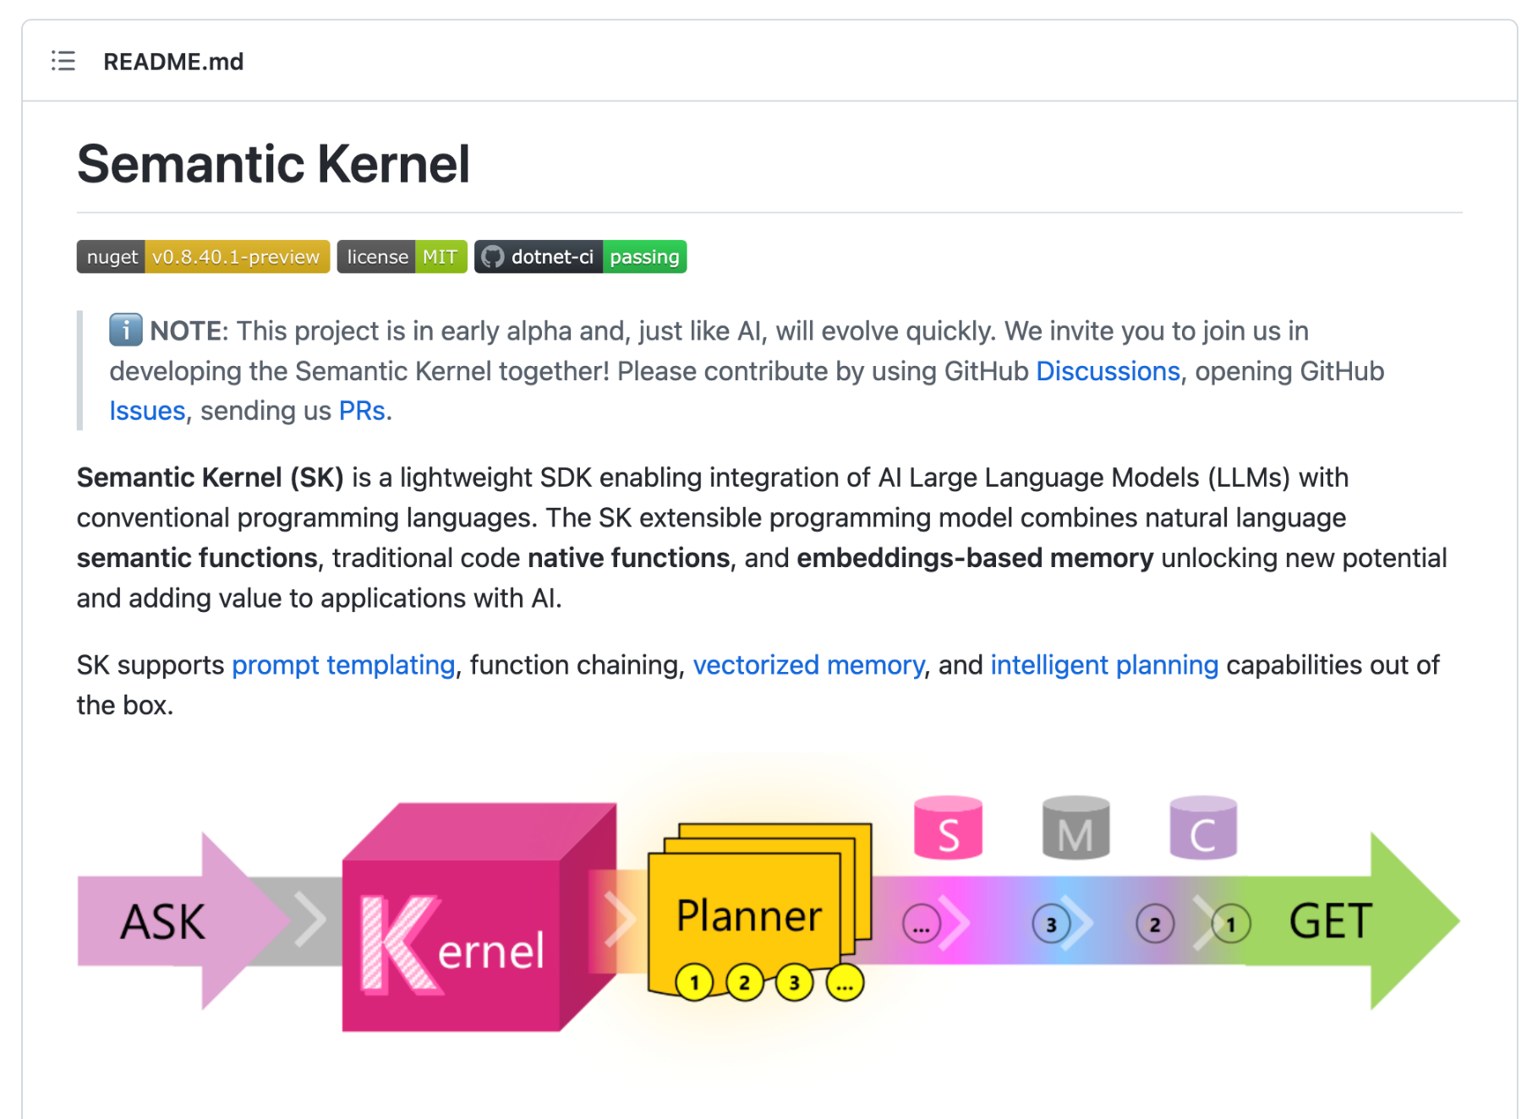
GitHub Repo (Open Source)
Join the Discord community
Follow the Blog for the latest news
Notes:
Semantic Kernel has more GitHub stars on a daily basis, more developers joining our open source Discord community, and regular blog posts are trending as well. You’ve joined Semantic Kernel at the right time!

Slide 12
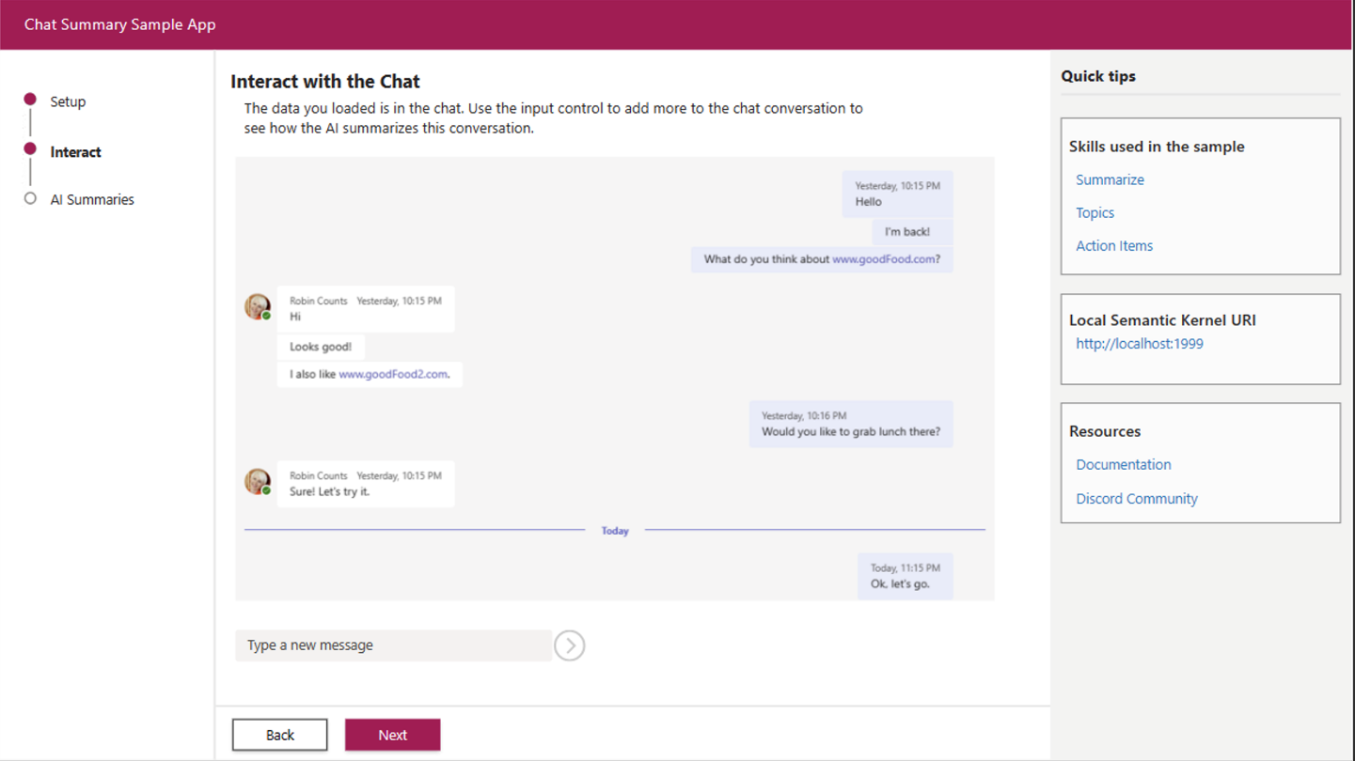
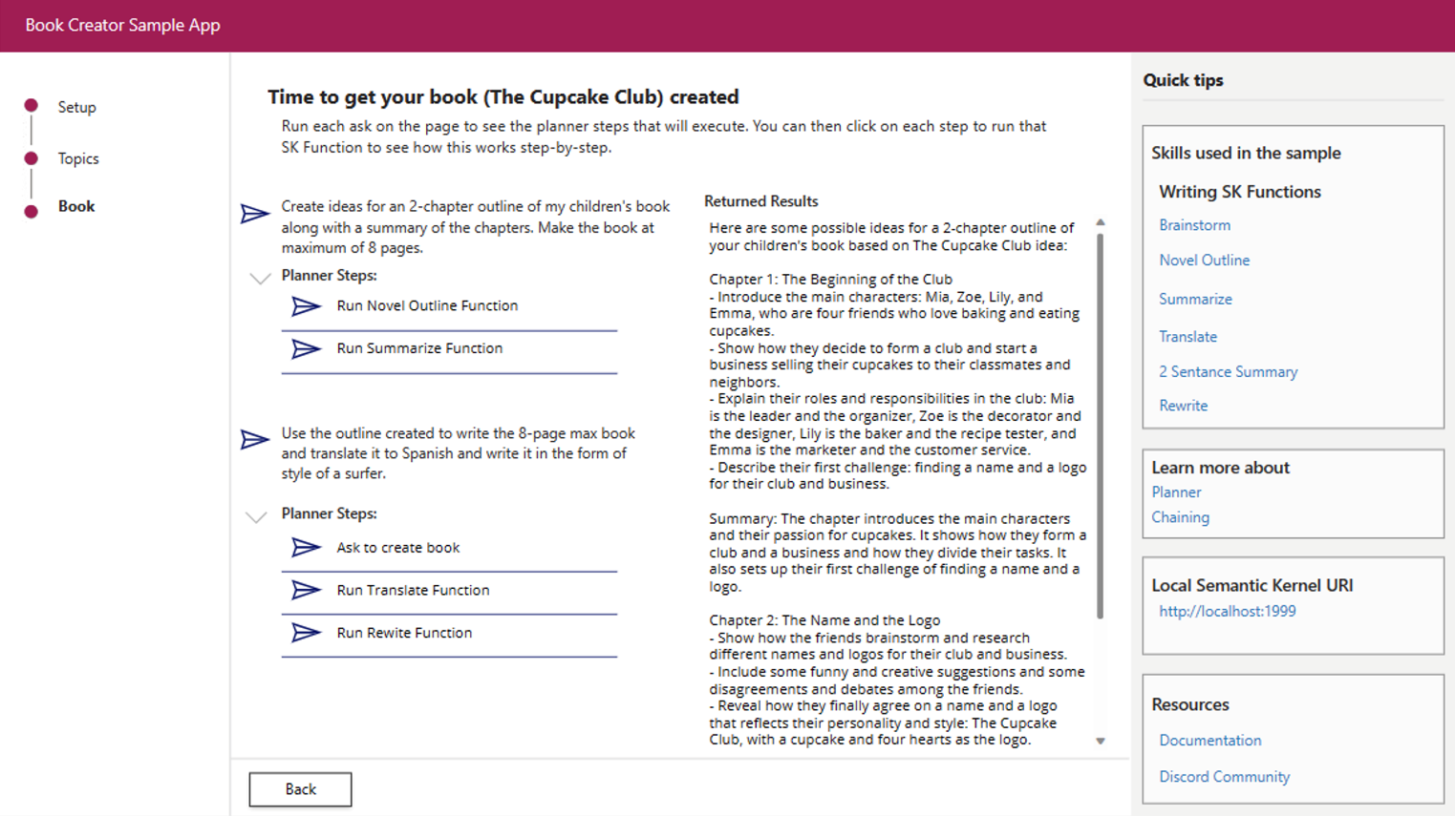
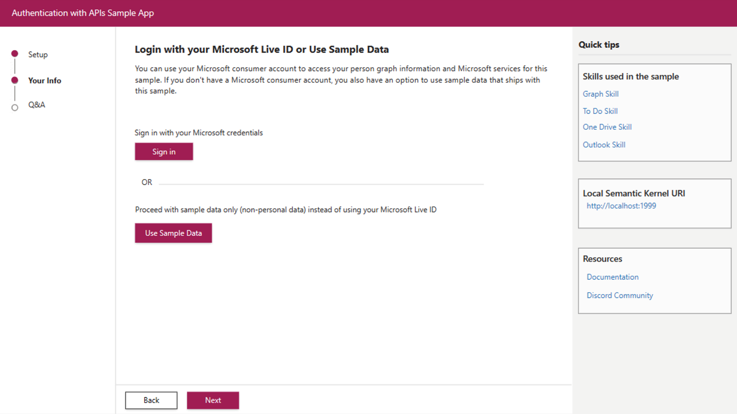
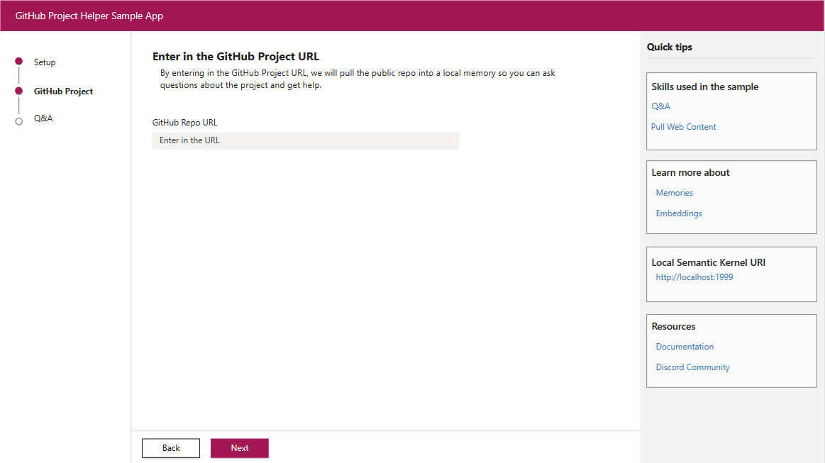
The growing set of samples are designed for most use cases.
Easily add chat-themed AI skills into your app.
Chain prompts serially or hierarchically via Planner.
Query MS Graph information with your favorite prompts.
Chat with your repo of choice using embeddings.
THE CHAT SAMPLE
THE PLANNER SAMPLE
THE MS GRAPH SAMPLE
THE EMBEDDING SAMPLE
Notes:
We’ll show you demos from the sample apps collection in the Semantic Kernel repo

Slide 13
Demo Video Links
Easily add chat-themed AI skills into your app.
Chain prompts serially or hierarchically via Planner.
Query MS Graph information with your favorite prompts.
Chat with your repo of choice using embeddings.
THE CHAT SAMPLE
THE PLANNER SAMPLE
THE MS GRAPH SAMPLE
THE EMBEDDING SAMPLE
Chat Sample Video
Book Creator Video
Graph Video
GitHub QA Video
Notes:
Use this slide if you are not doing to do your own demos and if you want to use the pre-recorded videos. You will need to jump forward about 60 seconds in each video to the app examples.

Slide 14
Meet the lightweight Kernel of Semantic Kernel.
“
I’ve been designed to orchestrate complicated LLM AI prompts combined with native code, use multiple AI models, and use a goal-oriented approach to achieving asks.”
STEPS
👋
PLANNER
1
2
3
…
ernel
ASK
K
“
I take a user’s ask and generate a step-by-step plan that draws upon available skills.”
Planner generates steps that use available Skills
SKILLS
Notes:
It all starts from an Ask. The user has a need that needs to be filled. Kernel, in Semantic Kernel, is the orchestrator for the Ask. It sends the Ask over to the Planner to the right skills can be found and the right steps can be created from the Ask and Skills.

Slide 15
Semantic Kernel pays down future technical debt asap.
💪 THE CORE
Everything you need to manage complex prompts, chains, long-running tasks, and planning.
SKILLS
RUNTIME
PLANNER
…
3
2
1
1
2
3
…
MEMORIES
DATA & SERVICES CONNECTORS
🤯 THE SWITCH
But wait, there’s more! All the longform memories readily available in the MS Graph. Plus, add data connectors.
MS GRAPH
+ YOUR DATA
APIs
Notes:
Models + skills are amazing and when you add personalized memories and real-time data they become an enabler for warp speed productivity.

Slide 16
Goals-First AI
ernel
ASK
K
It all starts with a user’s AI ask …
Steps ready from planner
1
2
3
…
Gather Skills
Gather Memories
V1 READY
Gather Connectors
SKILLS
APIs
… resulting in new productivity
GET
RUNNING STEPS PIPELINE
Result is ready
1
2
3
…
Execute Steps
Notes:
It always starts with an Ask. A user has a goal they want to achieve. We have seen how the Kernel orchestrates the ask to the planner. The Planner finds the right AI skills that can be used to solve that need. Some skills are enhanced with memories and with live data connections. The steps to complete the users ask are executed as part of the plan and the results are returned to the user, resulting in productivity gains and ideally the goal reached.

Slide 17
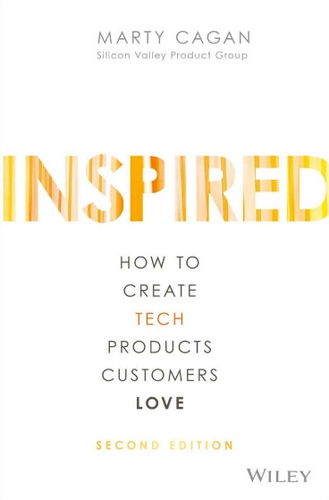
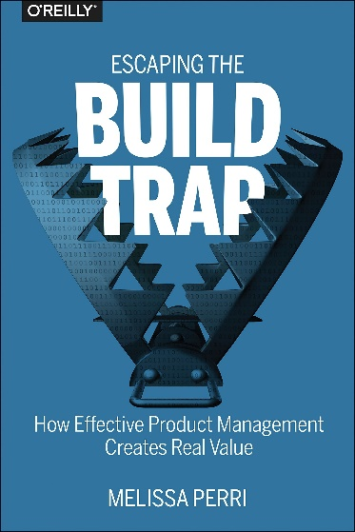
The switch to ”goals-first AI” aligns with products we ❤️
Software projects can be thought of as having two distinct stages. Figuring out what to build (= build the right product), then build it (= build the product right).
Keep the focus on minimal product. Don’t define the ultimate product. Define the smallest possible product that will meet your goals.
—Marty Cagan
Create Products Customers Love
We ask ourselves the following: What is the goal? Where are we now in relation to that goal? What is the biggest problem or obstacle standing in the way of me reaching that goal? How do I try to solve that problem? What do I expect to happen (hypothesis)? What actually happened, and what did we learn?
—Melissa Perri Escaping the Build Trap
PRODUCT THINKING = GOAL-ORIENTED APPROACH
Notes:
AI can be incredibly powerful, but it needs to be used to solve customer needs. You will discover how fast you can iterate and deploy solutions using these new methods. Focus on the customers problems that need to be streamlined and solved. What is the goal they are trying to achieve with software? Up next, we will dive into how we should start thinking about the customer and how we can ensure we are solving the right problems, as fast and as small as possible.

Slide 19
XX Minute Pitstop Break

Slide 20
Win The Right Race With Design Thinking
📺
Notes:
To start, let’s orient ourselves on why we’re here. You’re here to *hack*. That means you’re ready to get into a racing car and move fast, make mistakes, and learn new things in a safe environment. We want to be sure your time will be well spent — so we’ll be using design thinking to increase the likelihood that will happen for you. Are you ready?
Overview video here: https://aka.ms/sk/hack/video/designthinking

Slide 21
Design Thinking In The LLM AI Era
3
Generate possible solutions
1
Summarize customer support or field logs
Empathize
Ideate
Visualize solution journeys and examples
4
Define
Prototype
Test
2
Categorize common problems
5
Simulate customer reaction
Stanford D-school “Design Thinking”
Notes:
Stanford D-School has developed a method called “Design Thinking” to accelerate innovation in organizations of all sizes. We will be using their five-step method, but also introducing how AI changes the game around using this methodology. For example, we can use SK to summarize customer support logs to EMPATHIZE. We can use SK to categorize common problems to

Slide 22
Empathize
Empathize
Think about your employees, customers, users
What should be a better, faster, different experience?
If you started today, how would you reimagine that process or experience?
If you have a magic wand what appears?

Slide 23
Define
Define
Leverage AI here based on what you learned from Empathize.
Try something like this:
“
I work at a company that is trying to solve X,Y,Z. I need you to help with come up with some use cases for X type of user trying to accomplish X type of result.
“

Slide 24
Ideate
Ideate
Now it is time to build some functions.
Start with creating Semantic functions (plain language)
Think about what additional APIs or systems would make this more powerful
Think about what user context or memories could make this amazing
Use the Notebooks to quickly create function and test them out

Slide 25
Prototype
Prototype
Use the samples to get your started OR add AI to your own app
The samples use the local API service to host the kernel
For prototyping you can use the same local service for your own app
For POCs or Pilots – deploy Semantic Kernel as an Azure Function
Basic function usage – see the Chat Summary example
Chaining of functions using Planner – see the Book creator example
API example – see the Query MS Graph example

Slide 26
Extra Credit

Slide 27
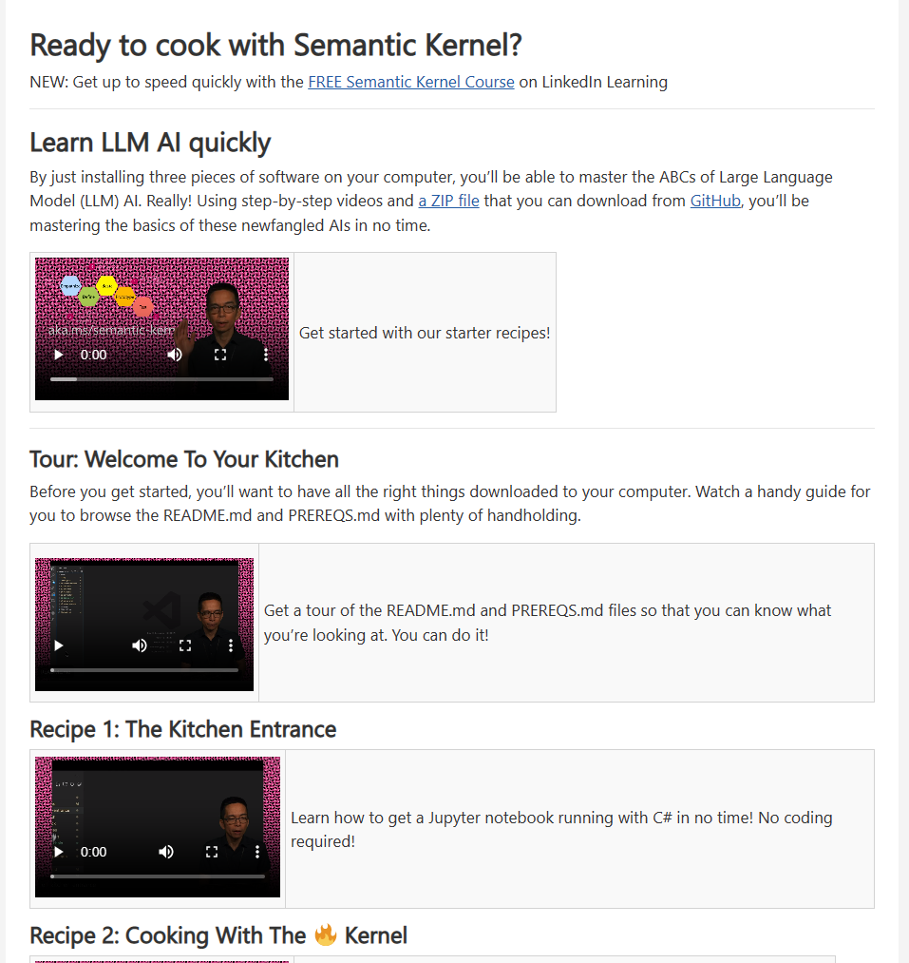
Not sure how this all fits together
Try the Semantic Kernel Recipes
https://aka.ms/sk/recipes
Notes:
We went through many new concepts so far. If you want to touch and feel how all of this works, try the Semantic Kernel Recipe Book. It will walk you through step-by-step through AI concepts in an easy-to-use course.

Slide 28
DEMO TIME!

Slide 29
Insert the team slides into this section
Send each team the slides sets to use for their presentation from the Team Demo Template

Slide 30
Feedback Time

Slide 31
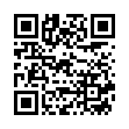
Feedback
What went well?
What could be better?
What would you like to see in the product?
Fill out the survey: aka.ms/sk/hack/feedback
Notes:
Wow, you did it. You created AI using the latest tech! Hopefully, you loved your experience along the way. Let’s share with each other how it went. What did you like, what could be better, what do you want to see in the product and in the hackathon next time. While we do this in the room, let’s make sure you scan the QR code so we share the feedback with the Semantic Kernel product team.

Slide 32
📺
Semantic Kernel Home
Public GitHub Repo
LinkedIn Learning Course
Technical Support
aka.ms/semantic-kernel
aka.ms/sk/repo
aka.ms/sk/li/introducing-semantic-kernel
aka.ms/sk/support
Notes:
Available thank you video from John: https://aka.ms/sk/hack/video/thankyou

